Slide 1

AMCAT Data Analysis

Slide 2
About me
I'm Zeba Samreen, and I hold a Bachelor's degree in Engineering and a Master's degree in Technology, both in Computer Science. I'm eager to pursue a career in Data Analysis and Data Science, where I can apply my skills and passion for working with data.
I want to learn Data Science because I am passionate and want to start my career in it.
Linkedin Url: https://www.linkedin.com/in/zebasamreen/
Github Url : https://github.com/ZebaSamreen

Slide 3
Data Description:
The dataset released by Aspiring Minds from the Aspiring Mind Employment Outcome 2015 (AMEO). The study is primarily limited only to students with engineering disciplines. The dataset contains the employment outcomes of engineering graduates as dependent variables (Salary, Job Titles, and Job Locations) along with the standardized scores from three different areas – cognitive skills, technical skills and personality skills. The dataset also contains demographic features. The dataset contains around Target variable Salary and 40 independent variables and 4000 data points. The independent variables are both continuous and categorical in nature.
Objective:
The primary objective of this project is to analyze and derive insights from the Aspiring Mind Employment Outcome 2015 (AMEO) dataset, focusing on engineering graduates. The project aims to explore the employment outcomes of these graduates by investigating the relationships between various independent variables, including standardized scores in cognitive skills, technical skills, personality skills, and demographic features.
Some of the goals are:
Data cleaning and preprocessing
Data Visualization
Explore Demographic Features such as Gender, State, City
Study Employment Outcomes
Correlation between target and independent features
Identify Key Factors

Slide 4
Libraries Used:
Pandas
Numpy
Matplotlib
Seaborn
Steps Performed:
Import necessary Libraries
Load the dataset.
Fix Column names.
Check null and duplicated values and clean them.
Detect and remove outliers.
Perform EDA
Perform non visualization and visualization univariate on categorical analysis on Numerical column.
Perform Bivariate Analysis
Conclusion

Slide 5
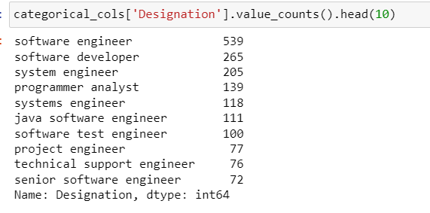
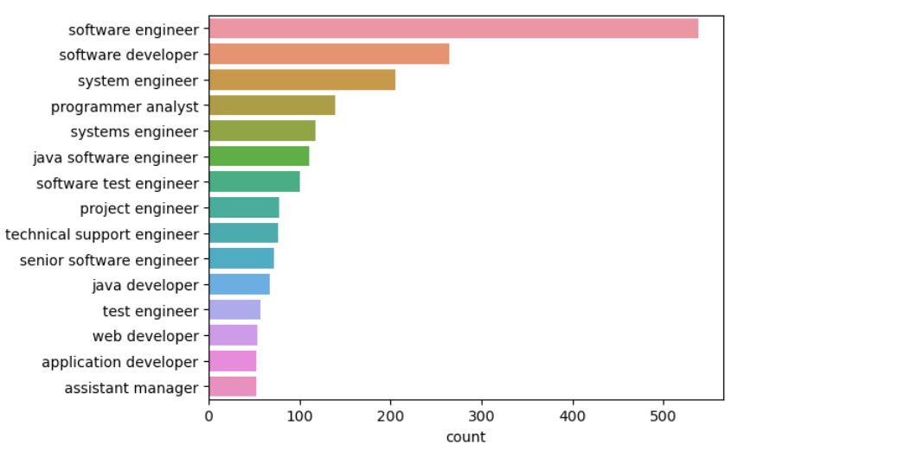
Univariate Analysis Of Categorical Columns: On Designation
From the above count we can observe that Top 3 Designations are:
Software Engineer
Software developer
System Engineer followed by others

Slide 6
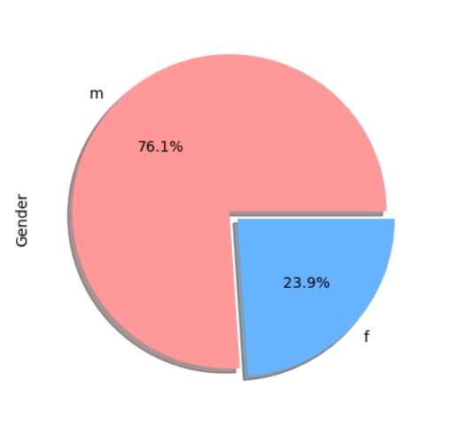
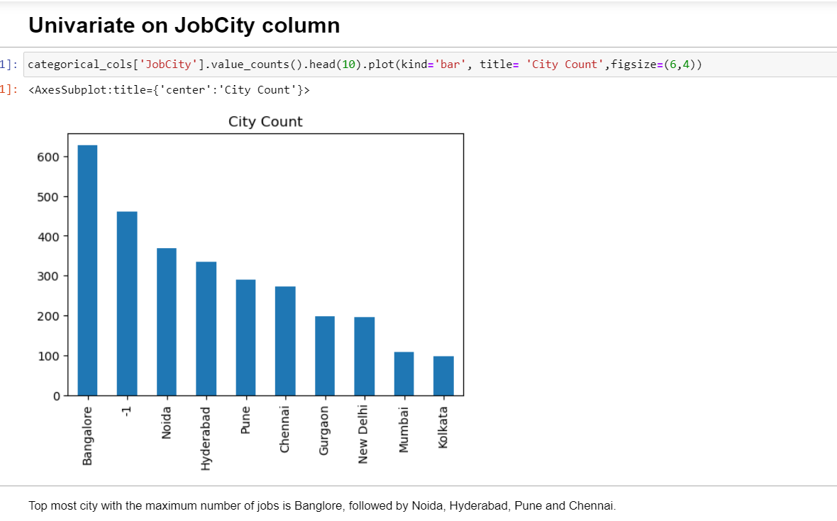
Univariate Analysis on JobCity and Gender
Percentage of Male is much much higher than Female which is 76.1%

Slide 7
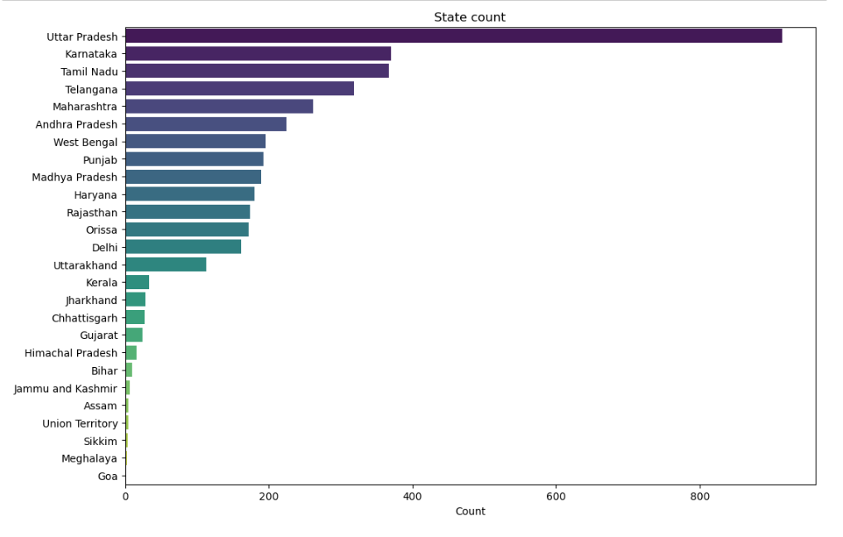
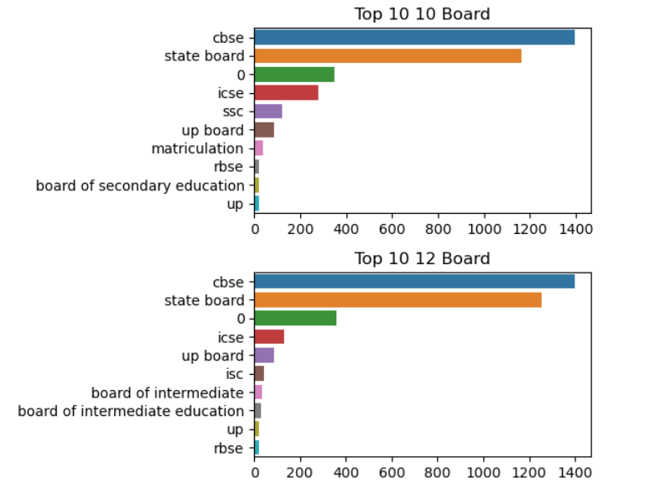
Top10 10Board and 12Board and State
Top board opted by students is:
CBSE, State board and icse in both 10th and 12th.
Most students are from CBSE Board
Majority of the students have studied from UP, followed by karnataka, tamil nadu and telangana and least are from Goa

Slide 8
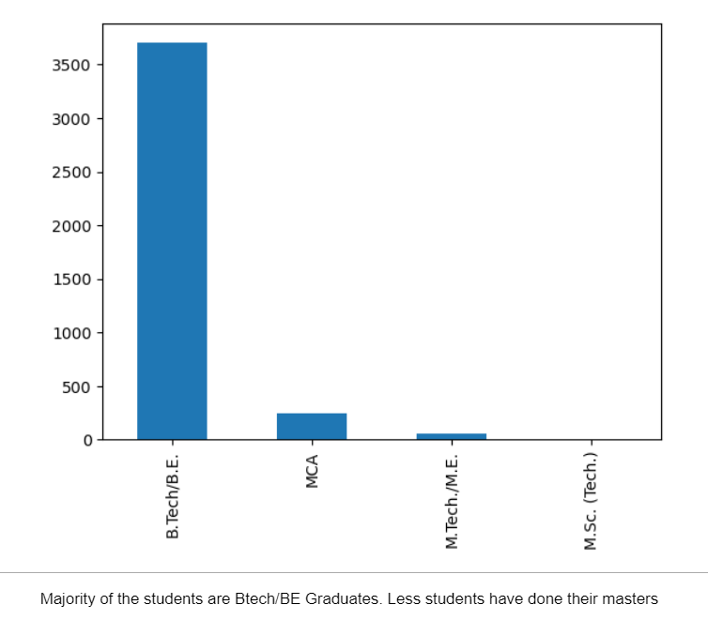
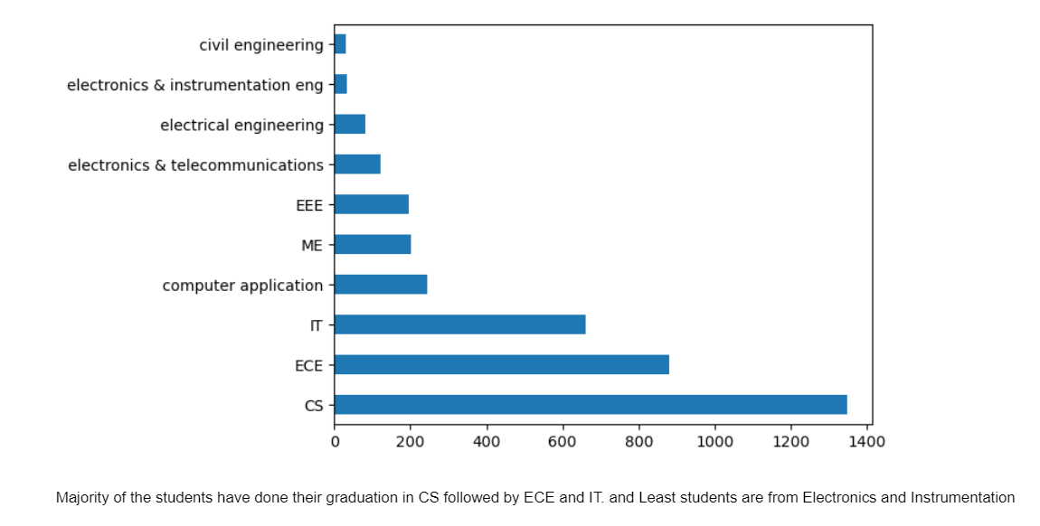
Degree and Specialization
Degree
Specialization
Specialization

Slide 9
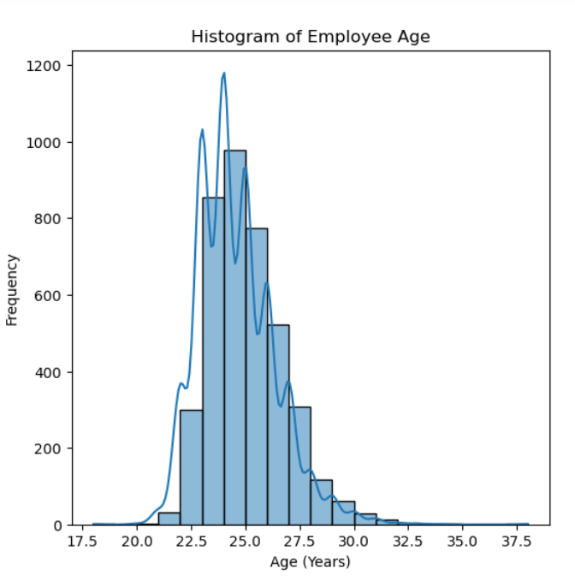
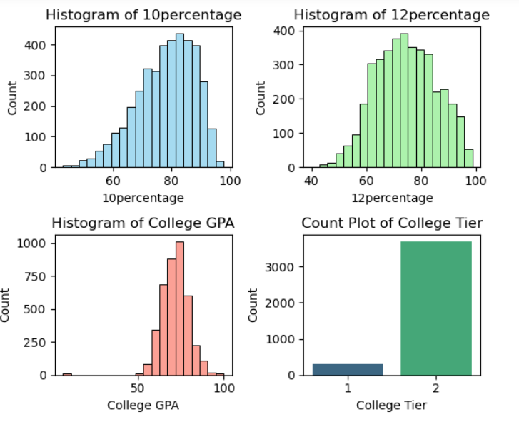
Age
We observe that most students are from tier 2 college
candidates have good 10 percentage
College GPA has normal distribution around mean gpa
10percentage is left skewed,students have higher 10% than 12
We can observe that majority of the employees have joined the company in the year 2015 and
majority of the employees has left the company in the same year 2015
Majority of the employees are aged between 32 to 35 years

Slide 10
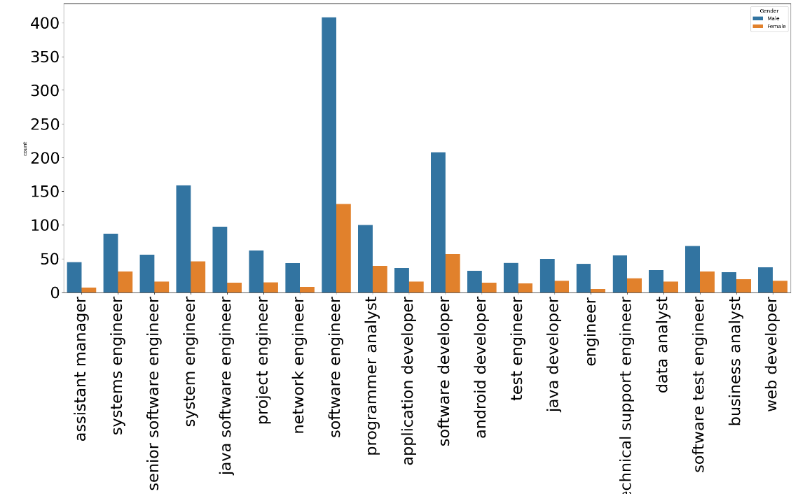
Bivariate Analysis on Salary and Designation
We observe that Majority of the candidates are Male, many candidates are working as software engineer and software developer
* Majority of the Females are working as Software engineer compared to other roles
* Majority of the candidates are working in software field because,majority of the candidates have done B.Tech from CS and IT Specialization

Slide 11
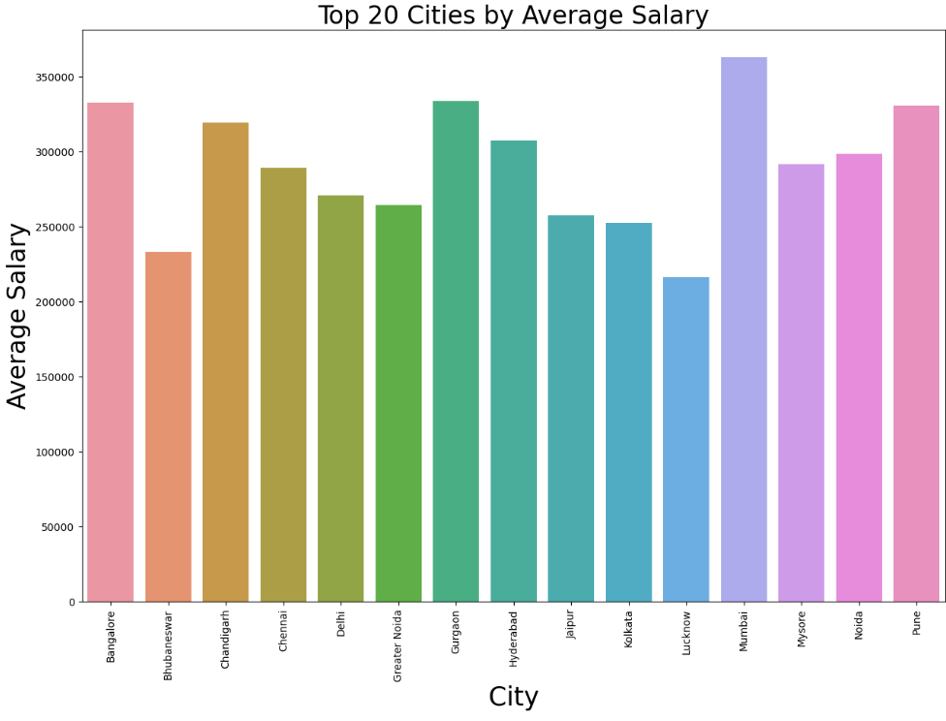
Candidates from Mumbai has the highest average Salary, followed by Banglore,Pune, Gurgaon and Hyderabad

Slide 12
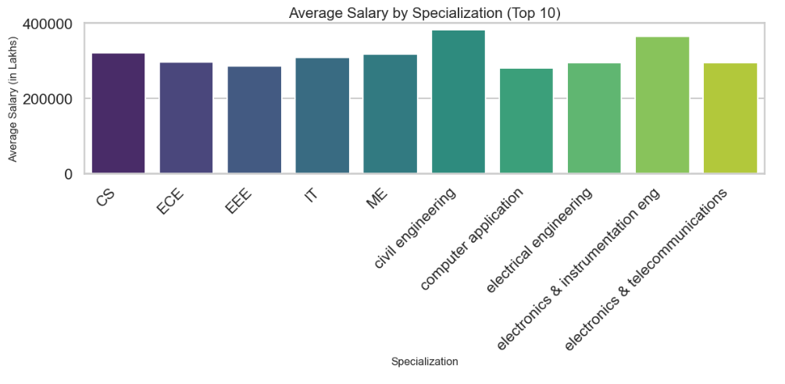
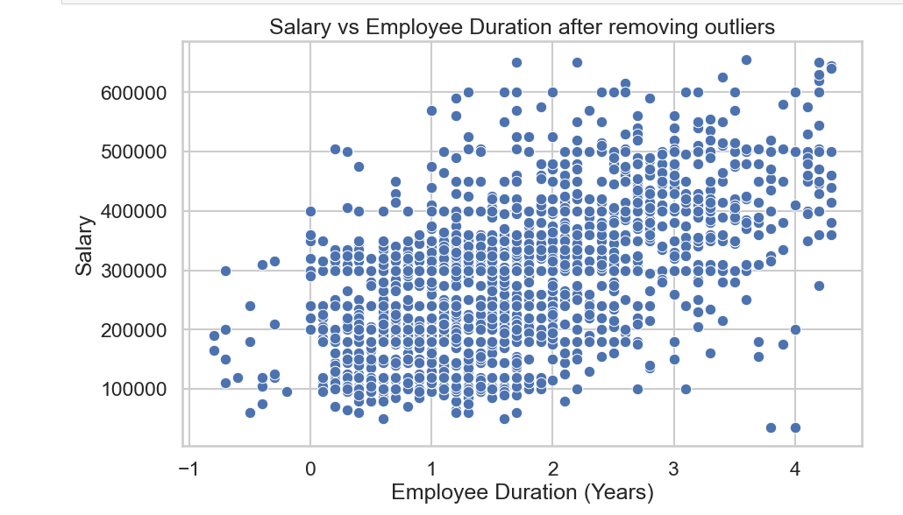
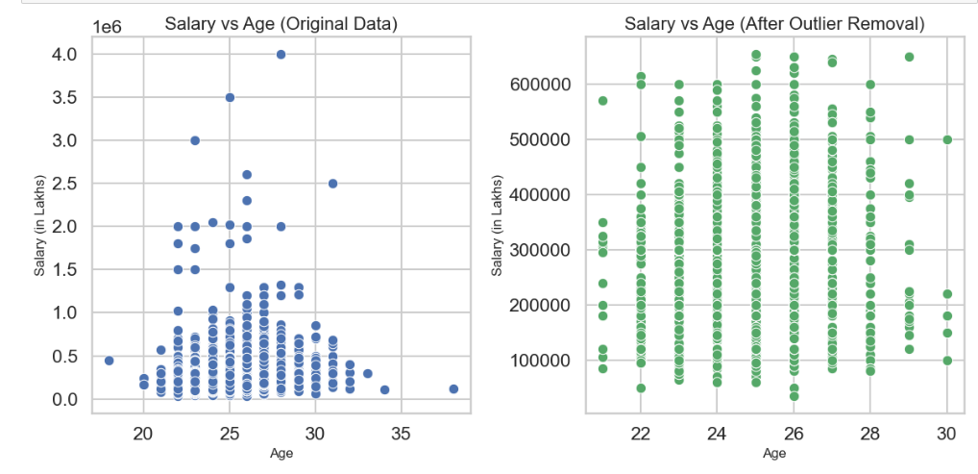
Duration of employees in the company have no much relation with high salary
From the scatter plot we see that there are few outliers
* candidates whose age is around 27 years has the highest salary, but we can also observe that candidates of around 22 years has same salary range as candidates older than 27 or 30 years
* which means Age is not related to higher salary which can be confirmed after removing outliers

Slide 13
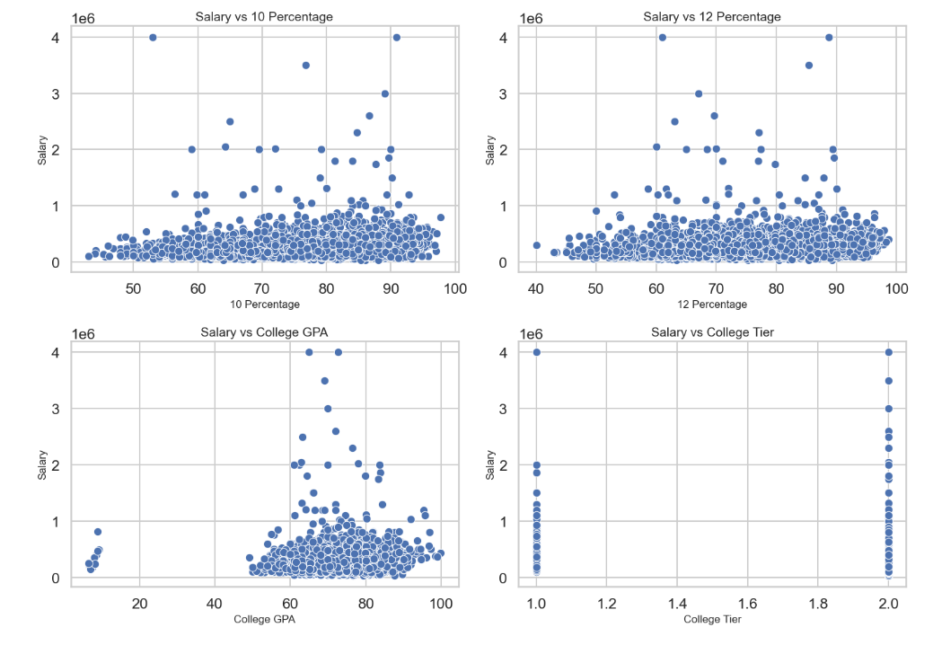
We observe that there is no strong relationship between Salary and 10,12,college GPA or college tier
That means candidates having high percentage does not mean they will be paid high.

Slide 14
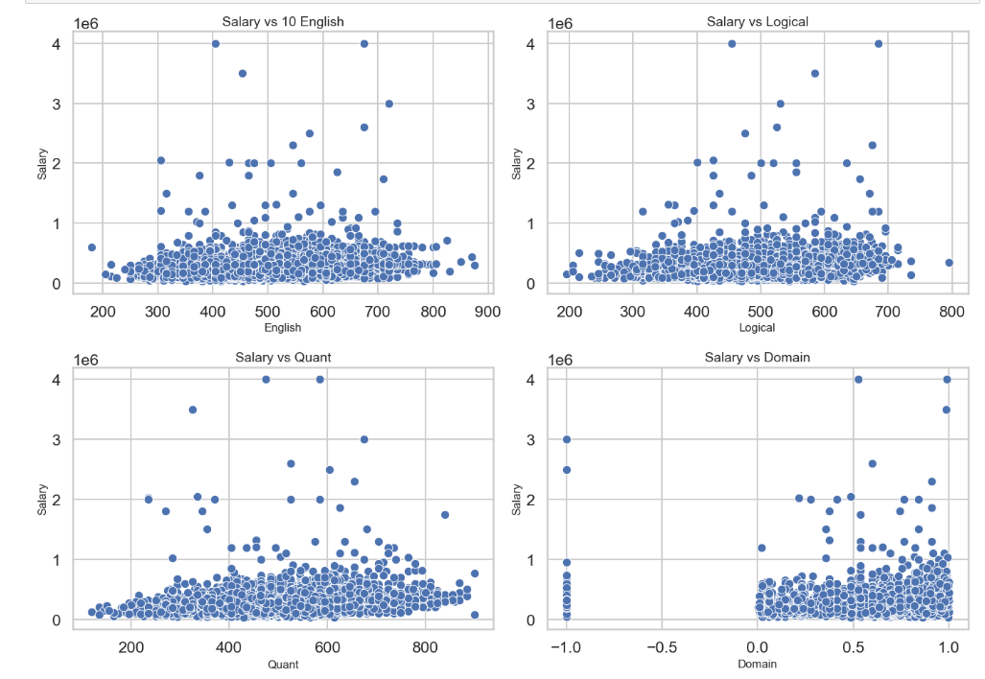
We can observe that candidates scoring more or less in English, quants or logical have no much relationship with their salaries

Slide 15
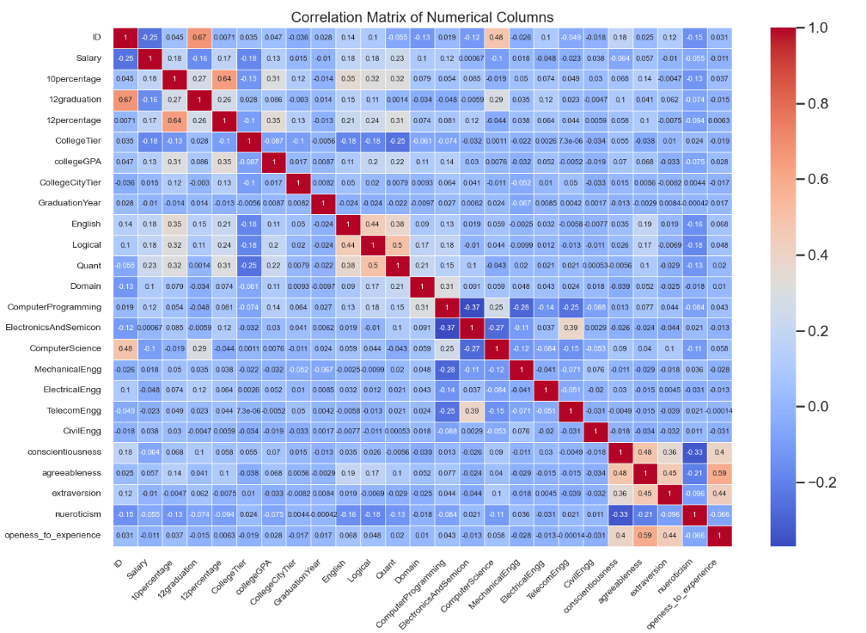

Slide 16
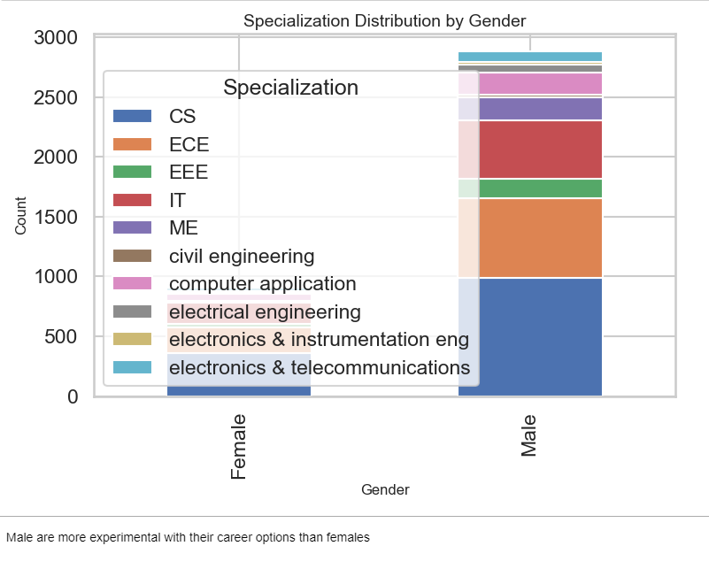
Is there a relationship between gender and specialization? (i.e. Does the preference of Specialisation depend on the Gender?)

Slide 17
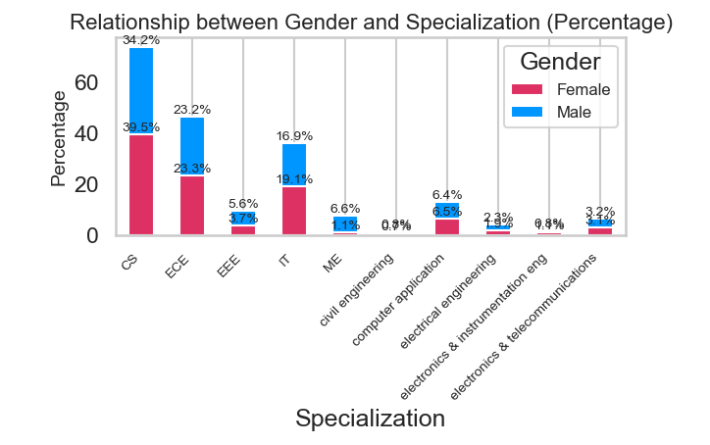
Is there a relationship between gender and specialization? (i.e. Does the preference of Specialisation depend on the Gender?)
We observe that Females are high in percentage in CS and IT field.
Males are high in percentage in Mechanical Engineeering and EEE
Male and Female are almost equal in ECE, electronics and communication

Slide 18
Conclusion
1. Gender Disparities: The analysis reveals a significant gender imbalance in the engineering workforce, with males comprising 76.1% of the total population. This highlights the need for initiatives to promote gender equality in engineering fields.The majority of employees fall within the 32 to 35 years age range
2. Educational Trends: The majority of graduates hold BTech/BE degrees, while the pursuit of advanced degrees remains low. This trend suggests the need for increased encouragement for further education among graduates.
3. Salary Insights: The average salary across the dataset is approximately 3.08 Lakhs,and maximum of 40Lakhs with Senior Software Engineers earning the highest average salary of over 5 Lakhs.Candidates from Mumbai enjoy the highest average salaries, followed closely by those from Bangalore ,Pune, Gurgaon, and Hyderabad. The validation of the Times of India claim regarding fresh graduates' salaries in programming and software engineering roles confirms the accuracy of current salary trends.
4. Specialization Choices: Computer Science, Electronics and Communication Engineering, and Information Technology are the most popular specializations, with females more prominent in CS and IT, while males dominate in Mechanical Engineering and EEE. This points to the need for targeted efforts to increase female participation in traditionally male-dominated specializations.

Slide 19

THANK YOU

